Slide 1
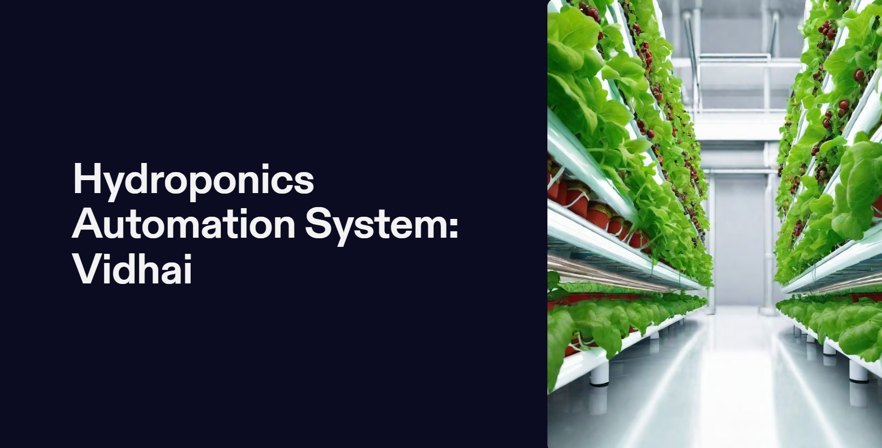

Slide 2
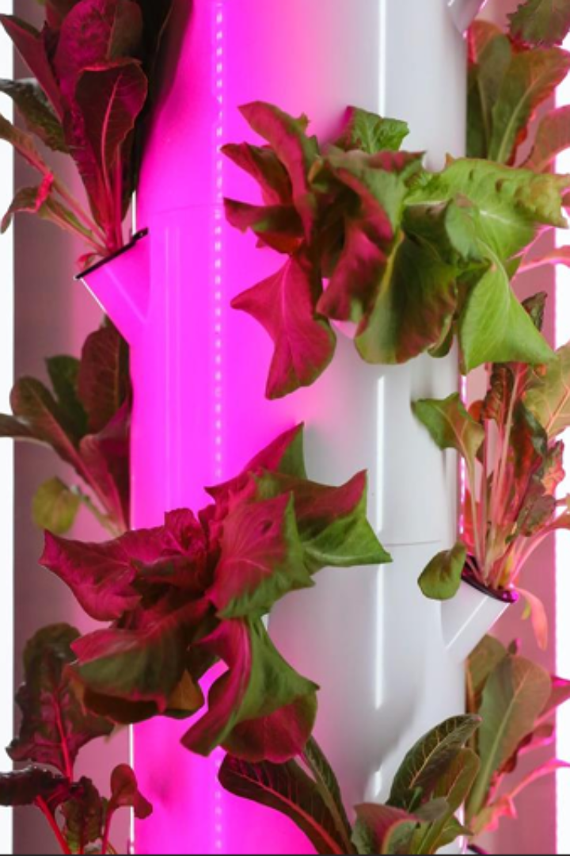

Problem Statement: Challenges Faced in Conventional Hydroponics
Traditional farming practices face numerous challenges such as soil degradation, limited resource efficiency, and susceptibility to climate fluctuations. In contrast, hydroponic systems offer a promising alternative by providing a controlled environment for plant growth, but they too encounter obstacles that impede widespread adoption.
Main Drawbacks of Hydroponics include the following:
• Nutrient and Water Resource Management
• Climate Control
• Real Time Monitoring, Remote Control Limitations

Slide 3
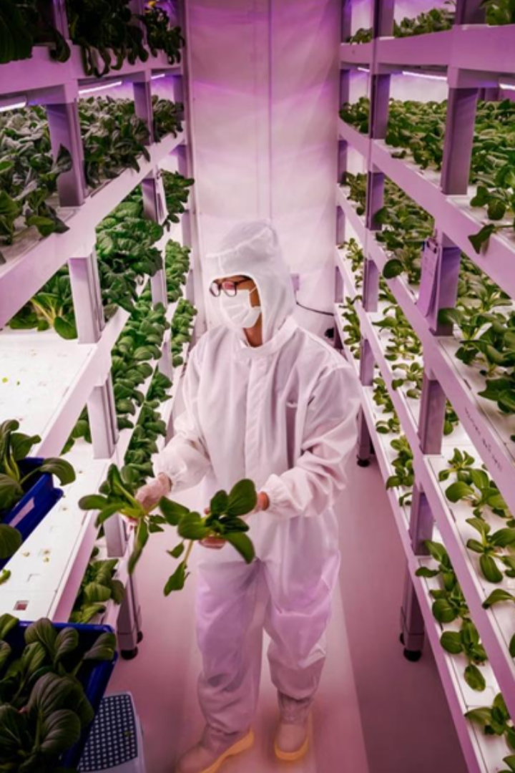
Automated Hydroponics: A Clever Business Solution
Advanced Monitoring: Real-time analysis of environmental parameters, ensuring precise control over nutrient delivery and environmental conditions.
Data-Driven Decision Making: Provides valuable insights through advanced analytics, enabling informed decisions for maximizing crop yield.
Enhanced Crop Yield: The synergy of automation with hydroponics ensures a consistent, year-round production cycle.
Sustainability: By eliminating soil and incorporating automation, our system addresses the challenges of traditional farming while promoting sustainable agriculture practices.

Slide 4
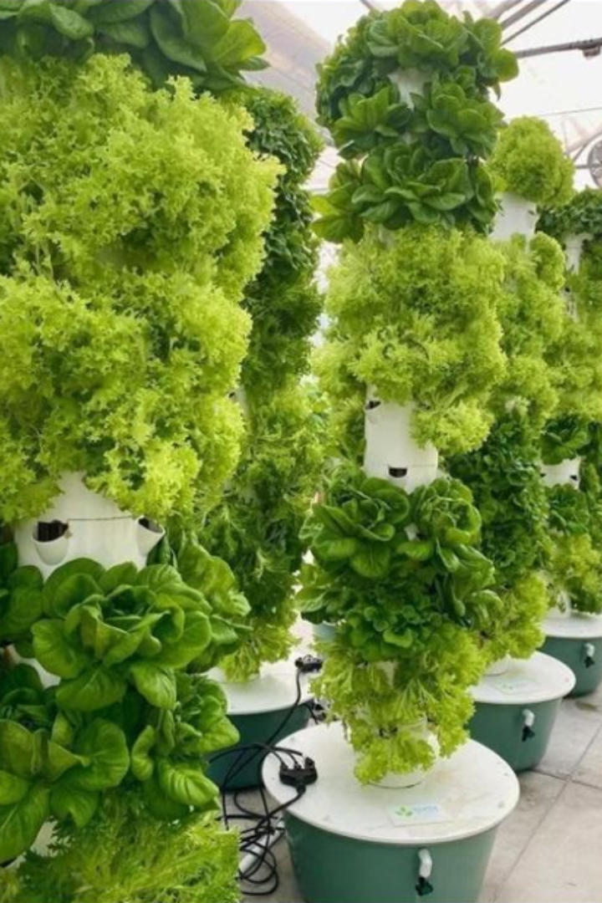
Unique Selling Proposition
Urban Agriculture Redefined: Break free from city constraints. Our solution empowers you to grow crops anywhere in the city, minimizing transportation costs and bringing farming to your doorstep.
Minimal Labor, Maximum Yield: Say goodbye to excessive labor costs. Our system's automation reduces the need for extensive manual work, maximizing efficiency and minimizing labor expenses.
Year-Round Productivity: Break free from seasonal constraints. Our system ensures year-round production, offering a reliable and consistent supply of fresh crops irrespective of external factors.
Effortless Automation: No more gardening grind! Our system takes care of everything automatically, making plant-growing a breeze.

Slide 5
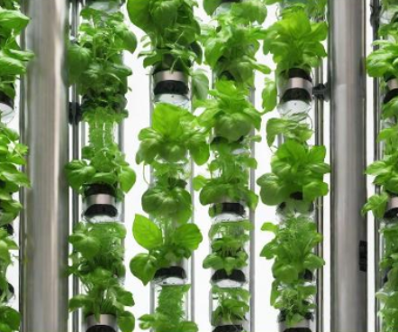
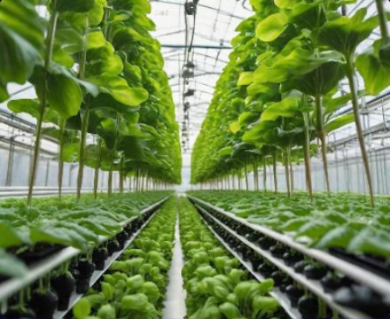
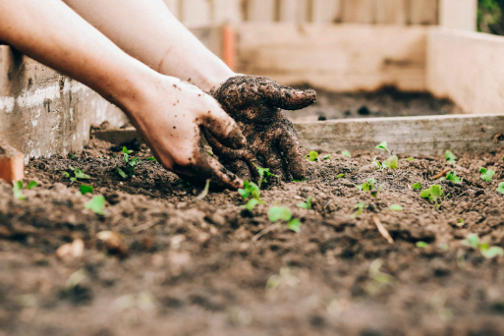
Target Market
Urban Farming
Commercial Hydroponics
Home Gardening
Riding the wave of sustainability and health consciousness, our customers are willing to pay a premium of up to 25% more for hydroponically grown products compared to conventionally grown alternatives.
According to Mordor Intelligence, the global hydroponics market reached $23.94 billion in 2020 and is projected to grow at a robust CAGR of 6.8% from 2021 to 2026.
Our primary market includes providing automation solutions for small, medium scale hydroponic nurseries actively providing locally grown, pesticide-free fresh produce but by using conventional techniques. Our methods boost the efficiency, cut labor costs, and embrace modern farming with our innovative solutions.
Source: Parna farms, Coimbatore.

Slide 6

Initial Revenue Plan
Revenue Model
Providing Customized Automation for existing Hydroponics Businesses with various pricing options based on size and type of setup.
Providing Subscription based Maintenance plans for the Automated Hydroponics Setups.
Future Expansions
Expand services to more cities.
Establish our own farms and supply fresh produce to local markets, Hotels, etc.,
Provide automated hydroponic kits to individual customers as an additional revenue stream.

Slide 7
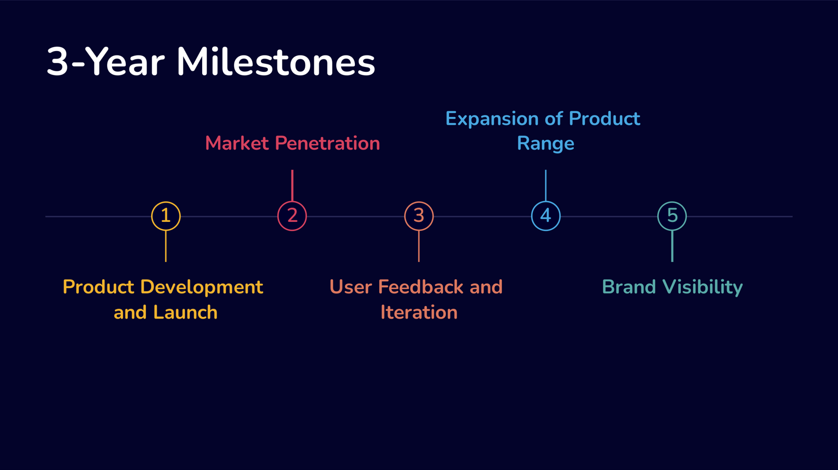

Slide 8
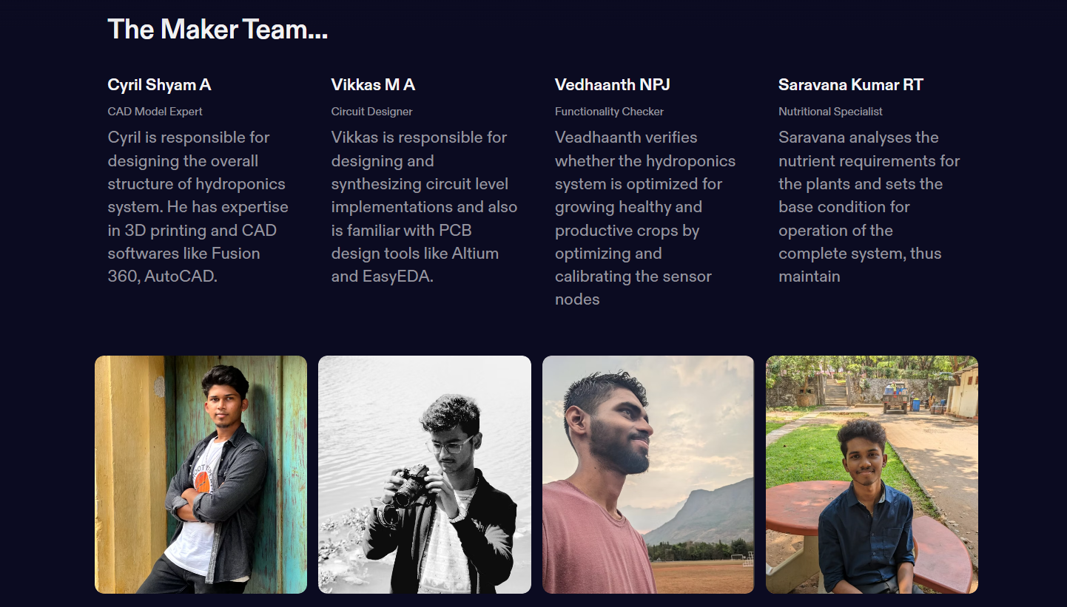

Slide 9
